Slide 1


Infosecurity Magazine Webinar
Modernizing your Application Security Program
Sponsored By:
#InfosecWebinar
@InfosecurityMag

Slide 2



Modernizing your Application Security Program
Panel:
Dan Kuykendall Senior Director, Application Security Products, Rapid 7
Dan Cornell CTO and Principal, Denim Group
Justin Clarke Chair, London Chapter of OWASP & Head of Research , Gotham Digital Science
Moderator:
Mike Hine, Deputy Editor, Infosecurity Magazine (@InfosecDepEd)

Slide 3
Poll question: Which of the following web service technologies are you most concerned about?
Mobile apps
AJAX (DOM)
RESTful Interfaces (JSON, SOAP, etc.)
Shopping Cart
Other

Slide 4


APPLICATION ASSESSMENT
FOR THE MODERN WORLD

Slide 5
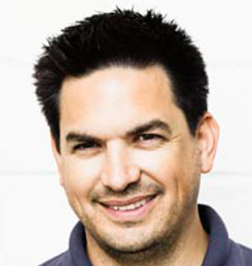
Introductions
Dan Kuykendall
Senior Director,
Application Security Products
Former co-CEO & CTO of NT OBJECTives
Notes:
Dan has been focused on application security and building application security software for more than 12 years as one of the founders and as the CTO of NT OBJECTives. He has lead the development of NTOSpider, which has recently been renamed AppSpider to fit within Rapid7. Dan has been and will continue to be responsible for the strategic direction and development of AppSpider products at Rapid7.
Dan joined NTO from Foundstone, where he was a key developer of FoundStone’s scan management, and remediation capabilities. Before Foundstone, Dan was the founder of the Information Security team in the United States branches of Fortis.
When Dan’s not working on NTO products or screen sharing with our customers to help them solve their application security challenges, you’ll find him blogging, co-hosting An Information Security Place Podcast and speaking at conferences like B-Sides, OWASP AppSecUSA, HouSecCon, ToorCon and more. He also works with industry groups and contributes to many open source development projects. Little known fact about Dan, he was a founder of the phpGroupWare project and creator of podPress.

Slide 6


Who was NT OBJECTives?
Founded in 2002 with an obsessive focus on Application Security
Customers include Fortune 100 and large Government organizations
Acquired for the capability to address modern applications
Notes:
The reason we bought NT OBJECTives is because the modern applications had advanced so rapidly, that we needed a solution that addressed the technologies used in modern applications.

Slide 7

Application security is a key challenge

Slide 8
Web applications are a primary target…
Accounted for up to 35% of confirmed breaches in some industries.
The 2015 Verizon Data Breach Investigation Report
35%
Notes:
As you probably know, web applications have and continue to be a primary target. The 2015 Verizon Data Breach Report highlights that application attacks remain the most frequent incident pattern in confirmed breaches and they accounted for up to 35% of breaches in some industries.
The Verizon report also estimated that nearly 50% of those incidents take months or longer to discover. So, how long ha this been going on? How long have we known about applications as a primary attack target?

Slide 9
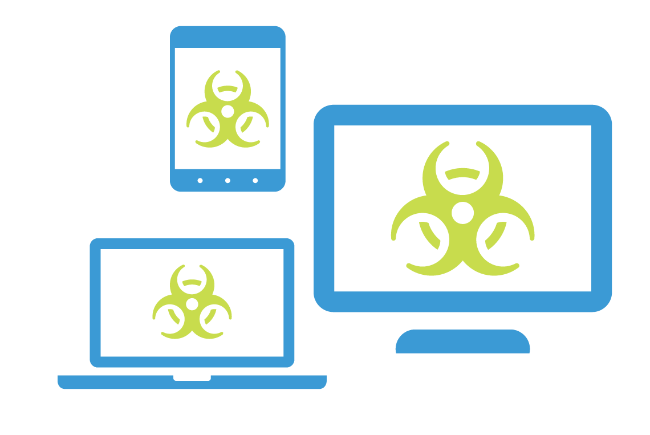


So, why is application security so hard?
Attackers
Attacks
Applications
Constant Evolution
Notes:
Well, the answer is that application security is a very dynamic environment. Everything is changing. Constantly and rapidly. The attackers or threat actors are changing. The actual attacks are evolving. And, the applications themselves are evolving significantly. The tools and processes we used in 2000, simply aren’t enough anymore. Let’s dive into each of the areas a bit to understand how they have evolved and how they are continuing to evolve, beginning with the attackers.

Slide 10
Why don’t existing tools solve these challenges?

Slide 11
Plenty of free attacking tools
Nickto & Wicto
SQLMap
w3af
Burp Suite
Skipfish
Grendal-Scan
ZAP Proxy
Etc, etc, etc…
All great exploit tools

Slide 12

Attacking is the easy part

Slide 13

You can’t attack what you can’t see

Slide 14

Know Your WEAK Points
Coverage for Modern Applications

Slide 15
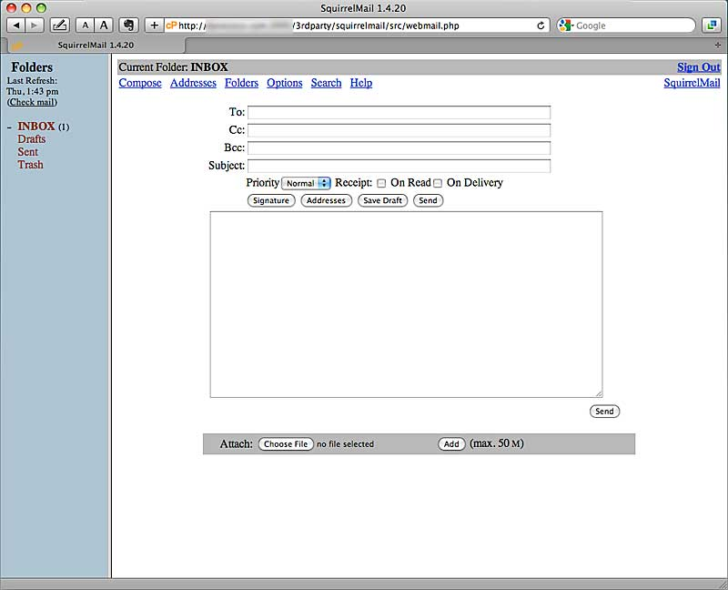
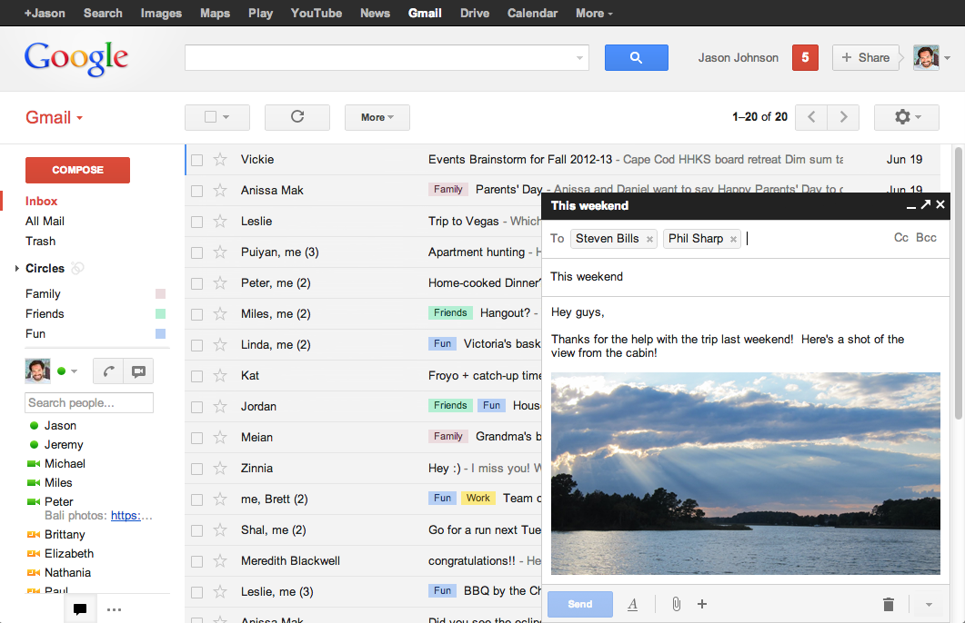
Coverage for Modern Technologies
Evolving application complexity
Then: HTML, with iFrames
Now: Rich client (AJAX, HTML, Javascript) & Web services (JSON, GwT, SOAP, etc.)
Notes:
Now., lets look at the evolution of applications. On the left, we have one of the original amazon.com sites that was likely written in primarily in HTML. Then, on the left, we have today’s amazon.com site that has a much richer user experience and a lot of additional complexity. I’m just using the amazon site as an example, I don’t know exactly what code is in it, but many modern applications like this today have HTML, Javascript and AJAX and in the client and then they have RESTful web services with JSON, SOAP, etc. Amazon use numerous web service to verify Prime accounts or to update inventory from other sellers.
Let’s look at this application evolution in a slightly different way…

Slide 16
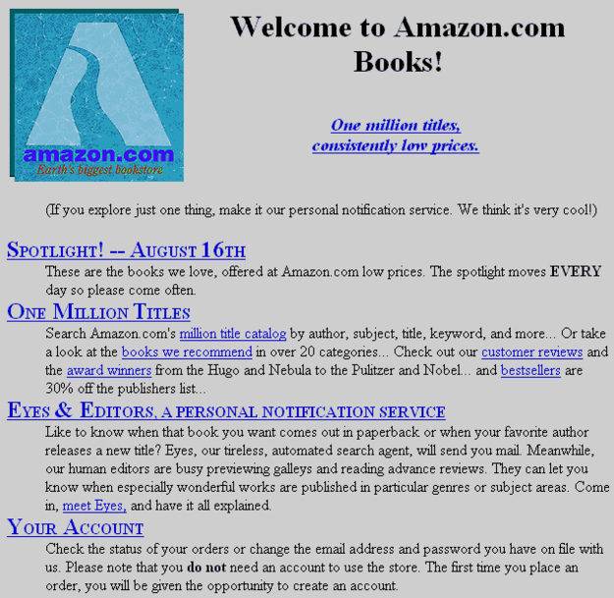
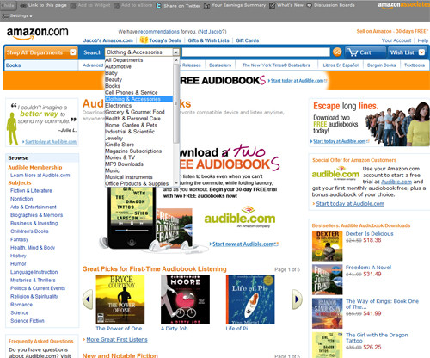
Coverage for Modern Technologies
Evolving application complexity
Then: HTML, with iFrames
Now: Rich client (AJAX, HTML, Javascript) & Web services (JSON, GwT, SOAP, etc.)
Notes:
Now., lets look at the evolution of applications. On the left, we have one of the original amazon.com sites that was likely written in primarily in HTML. Then, on the left, we have today’s amazon.com site that has a much richer user experience and a lot of additional complexity. I’m just using the amazon site as an example, I don’t know exactly what code is in it, but many modern applications like this today have HTML, Javascript and AJAX and in the client and then they have RESTful web services with JSON, SOAP, etc. Amazon use numerous web service to verify Prime accounts or to update inventory from other sellers.
Let’s look at this application evolution in a slightly different way…

Slide 17
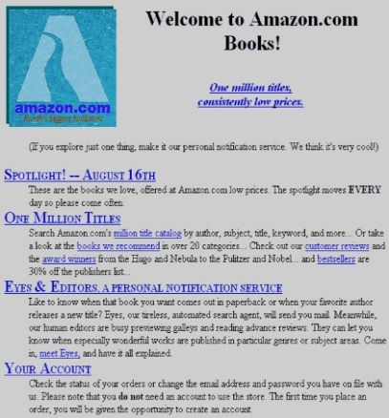
Coverage for Modern Technologies
Evolving application complexity
AJAX, Flash/Flex, Silverlight
JSON, REST, AMF, SOAP
Web 3.0
& Mobile
HTML
Static Pages
Scripted Pages
Javascript
Web 2.0 (AJAX)
Application Frameworks
(SOA’s)
CGI
1990
1995
2000
2005
2010
2015
2020
Notes:
Now., lets look at the evolution of applications. On the left, we have one of the original amazon.com sites that was likely written in primarily in HTML. Then, on the left, we have today’s amazon.com site that has a much richer user experience and a lot of additional complexity. I’m just using the amazon site as an example, I don’t know exactly what code is in it, but many modern applications like this today have HTML, Javascript and AJAX and in the client and then they have RESTful web services with JSON, SOAP, etc. Amazon use numerous web service to verify Prime accounts or to update inventory from other sellers.
Let’s look at this application evolution in a slightly different way…
This graph shows how applications have evolved, from static HTML pages in 1990, to having Javascript in 2005, to Web 2.0 in 2010 and finally today, we have what many people call Web 3.0 or Rich Internet applications with back end RESTful services found in mobile and other places like the web services on Amazon.com as we just discussed. As you can see from this slide, this is a lot of change…

Slide 18

Crawling modern applications

Slide 19

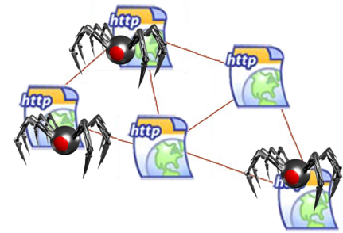
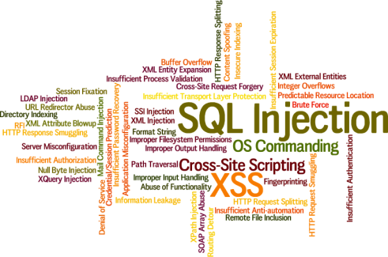
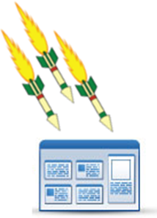
Coverage for Modern Applications
Traditional Web Crawling & Scanning
Crawler
Standard Parser
Attacker
Start
GET /search.asp?item=Shirt&color=Blue
POST /search.asp
item=Shirt&color=Blue
You can’t attack what you can’t crawl
color=Blue” onmouseover=“alert(123)
Notes:
Traditionally, scanners worked using a “crawl & attack” model. The crawler crawled all of the links and inputs in the application and parsed HTML & Javascript. The scanners parsers’ could only parse basic HTTP/HTML formats. After the crawl and parse, the scanner conducts an “attack” where it modifies inputs with attack payloads like SQL Injection and cross site scripting. First it sends the attacks, then the responses are analyzed for vulnerability discovery.
Some scanners have been claiming to support new formats
They are internally built for ‘name=value’
They try converting complex data structures into old flat structures
This does not work

Slide 20
Scanning Traditional Web Apps
In the past we had well defined and easy to parse/attack input formats
Inputs in simple ‘name=value’ pairs
Same for POST requests
GET /search.php?item=Shirt&color=Blue HTTP/1.1
Accept: text/html, application/xhtml+xml, */*
Referer: http://www.webscantest.com/crosstraining/
Accept-Language: en-US
User-Agent: Mozilla/5.0 (compatible; MSIE 9.0; Windows NT 6.1)
Host: www.webscantest.com
Cookie: SESSIONIS=aslkjhalasdhh2979jhfac78h
POST /search.php HTTP/1.1
Accept: text/html, application/xhtml+xml, */*
Referer: http://www.webscantest.com/crosstraining/
Accept-Language: en-US
User-Agent: Mozilla/5.0 (compatible; MSIE 9.0; Windows NT 6.1)
Host: www.webscantest.com
Cookie: SESSIONIS=aslkjhalasdhh2979jhfac78h
item=Shirt&color=Blue

Slide 21
AJAX & Mobile
  REST: REpresentational State Transfer
    Custom URL handlers
    XML Formats
  JSON: JavaScript Object Notation
Flash & Flex Applications: AMF
Many others: GWT, SOAP,
XML-RPC & custom formats
GET /rest/search/item/Shirt/color/Blue
POST /rest/
<search><item>Shirt</item><color>Blue</color></search>
POST /json/
{“search”: {“item”: Shirt ; “color”: Blue} }
POST /amf/amf.php
□□□□□□□□null□□□□/3□□□<
□□□□□
□□Oflex.messaging.messages.RemotingMessagesource□operation□search□item□color
□□□□Shirt□ Blue□
□□ DSId□IBA98D1B7-SE1C-6007-6D98-2CEF173C5AF□SEndpoint□my-amf□□IOB63
POST /GWT/
Search|Shirt|Blue|

Slide 22


Coverage for Modern Applications
Traditional Web Crawling & Scanning
Crawler
Standard Parser
Attacker
Start
GET /search.asp?item=Shirt&color=Blue
POST /search.asp
item=Shirt&color=Blue
You can’t attack what you can’t crawl
color=Blue” onmouseover=“alert(123)
Notes:
Traditionally, scanners worked using a “crawl & attack” model. The crawler crawled all of the links and inputs in the application and parsed HTML & Javascript. The scanners parsers’ could only parse basic HTTP/HTML formats. After the crawl and parse, the scanner conducts an “attack” where it modifies inputs with attack payloads like SQL Injection and cross site scripting. First it sends the attacks, then the responses are analyzed for vulnerability discovery.
Some scanners have been claiming to support new formats
They are internally built for ‘name=value’
They try converting complex data structures into old flat structures
This does not work

Slide 23

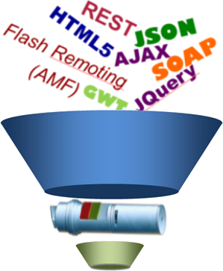



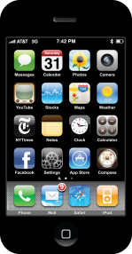
Universal Translator increases coverage, decreases false negatives
Crawler
Universal Translator
Attacker
Start
color=Blue” onmouseover=“alert(123)
Recorded
URO - Universal Request object
Type: JSON
Inputs
- http.cookie[0].session, 98734njfaius282
- filters[0].item, Shirt
- filters[1].color, Blue
Notes:
Parse HTML & Javascript
Find new links, and inputs
Mobile & Web services
JSON, REST, AMF, SOAP
Parses many formats into a common description
Modify URO with attack payloads
Attack Requests sent
Responses analyzed for vulnerability discovery

Slide 24
Coverage for Modern Technologies
RESTful services: Complex JSON example
Nicely formatted
As one line
{"products":[{"shirt":{"text":“NTO","colors":["blue","red","yellow","green"],"sizes":["small","medium","large","xlarge"],"price":"19.99"}},{"hat":{"text":“NTO","colors":["black","red"],"sizes":["kids","adult"],"price":"24.99"}}]}
{ "products" : [
{ "shirt" : {
"colors" : [
"blue",
"red",
"yellow",
"green"
],
"price" : "19.99",
"sizes" : [
"small",
"medium",
"large",
"xlarge"
],
"text" : “NTO"
} },
{ "hat" : {
"colors" : [
"black",
"red"
],
"price" : "24.99",
"sizes" : [
"kids",
"adult"
],
"text" : “NTO"
}
}
]
}
Nicely formatted
JSON supports
nested data
just like XML

Slide 25
Coverage for Modern Technologies
RESTful services: Complex JSON example blindly attacked
{"products":[{"shirt":{"text":“NTO","colors":["blue","red","yellow","green"],"sizes":["small","medium","large","xlarge"],"price":"19.99"}},{"hat":{"text":“NTO","colors":["black","red"],"sizes":["kids","adult"],"price":"24.99"}}]}
As one line
{"products":[{"shirt’_OR_1=‘1":{"text":“NTO","colors":["blue","red","yellow","green"],"sizes":["small","medium","large","xlarge"],"price":"19.99"}},{"hat":{"text":“NTO","colors":["black","red"],"sizes":["kids","adult"],"price":"24.99"}}]}
Attacked by other scanners
{"products":[{"shirt":{"text":“NTO","colors":["blue","red","yellow","green"],"sizes":["small","medium","large","xlarge"],"price":"19.99"}},{"hat":{"text":“NTO","colors":["black","red"],"sizes":["kids","adult"],"price":"24.99"}}]}’ OR 1=‘1
Accomplished nothing

Slide 26
Coverage for Modern Technologies
RESTful services: Complex JSON example converted & attacked
{"products":[{"shirt":{"text":“NTO","colors":["blue","red","yellow","green"],"sizes":["small","medium","large","xlarge"],"price":"19.99"}},{"hat":{"text":“NTO","colors":["black","red"],"sizes":["kids","adult"],"price":"24.99"}}]}
As one line
{"products":[{"shirt’_OR_1=‘1":{"text":“NTO","colors":["blue","red","yellow","green"],"sizes":["small","medium","large","xlarge"],"price":"19.99"}},{"hat":{"text":“NTO","colors":["black","red"],"sizes":["kids","adult"],"price":"24.99"}}]}
Converted & attacked by AppSpider
Successful delivery
{"products":[{"shirt":{"text":“NTO","colors":["blue","red’_OR_1=‘1","yellow","green"],"sizes":["small","medium","large","xlarge"],"price":"19.99"}},{"hat":{"text":“NTO","colors":["black","red"],"sizes":["kids","adult"],"price":"24.99"}}]}

Slide 27
Summary
Application development is evolving at a faster rate than security tools.
  How does this compare to what you are seeing?
  Are you seeing these technologies in your applications?
  Are security tools keeping up?
  How can vendors best help the industry?
  See for yourself how AppSpider addresses modern applications!
  AppSpider Free Trial
  www.rapid7.com/appspider

Slide 28
Modernizing your Application Security Program
Panel:
Dan Kuykendall Senior Director, Application Security Products, Rapid 7
Dan Cornell CTO and Principal, Denim Group
Justin Clarke Chair, London Chapter of OWASP & Head of Research , Gotham Digital Science
Moderator:
Mike Hine, Deputy Editor, Infosecurity Magazine (@InfosecDepEd)

Slide 29
Poll question: Which of the following server-side or web service technologies are you most concerned about?
Web Services
RESTful Interfaces
JSON
SOAP
XML RPC

Slide 30
Modernizing Your Application Security Program
Dan Cornell
@danielcornell

Slide 31
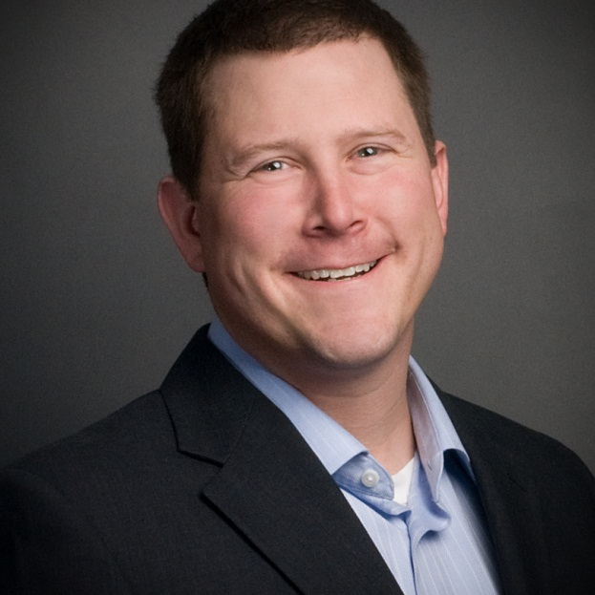
My Background
Dan Cornell, founder and CTO of Denim Group
Software developer by background (Java, .NET, etc)
OWASP San Antonio

Slide 32
Denim Group Background
Secure software services and products company
  Builds secure software
  Helps organizations assess and mitigate risk of in-house developed and third party software
  Provides classroom training and e-Learning so clients can build software securely
Software-centric view of application security
  Application security experts are practicing developers
  Development pedigree translates to rapport with development managers
  Business impact: shorter time-to-fix application vulnerabilities
Culture of application security innovation and contribution
  Develops open source tools to help clients mature their software security programs
    Remediation Resource Center, ThreadFix
  OWASP national leaders & regular speakers at RSA, SANS, OWASP, ISSA, CSI
  World class alliance partners accelerate innovation to solve client problems

Slide 33
So You Want To Roll Out a Software Security Program?
Great!
What a software security program ISN’T
  Question: “What are you doing to address software security concerns?”
  Answer: “We bought scanner XYZ”
What a software security program IS
  People, process, tools (naturally)
  Set of activities intended to repeatedly produce appropriately-secure software

Slide 34
Challenges Rolling Out Software Security Programs
Resources
  Raw budget and cost issues
  Level of effort issues
Resistance: requires organizational change
  Apparently people hate this
Open source tools
  Can help with raw budget issues
  May exacerbate problems with level of effort
View the rollout as a multi-stage process
  Not one magical effort
  Use short-term successes and gains to fuel further change

Slide 35
Now You Need to MODERNIZE Your Program
Lucky you
What does this mean?
  AJAX
  Web services
  Microservices
  RESTful APIs
Development moves FAST
Your application security program needs to be able to adapt
Coverage is key

Slide 36
You can’t defend unknown attack surface
If everything is important then nothing is important

Slide 37
[Translation]
Find out what applications you have in your organization
Decide the relative importance of applications and treat them differently based on this

Slide 38
What Is Your Software Attack Surface?
Software You Currently Know About
What?
Critical legacy systems
Notable web applications
Why?
Lots of value flows through it
Auditors hassle you about it
Formal SLAs with customers mention it
Bad guys found it and caused an incident (oops)

Slide 39
What Is Your Software Attack Surface?
Add In the Rest of the Web Applications You Actually Develop and Maintain
What?
Line of business applications
Event-specific applications
Why Did You Miss Them?
Forgot it was there
Line of business procured through non-standard channels
Picked it up through a merger / acquisition

Slide 40
What Is Your Software Attack Surface?
What?
More line of business applications
Support applications
Infrastructure applications
Why Did You Miss Them?
Most scanner only really work on web applications so no vendors pester you about your non-web applications
Assume the application vendor is handling security
Add In the Software You Bought from Somewhere

Slide 41
What Is Your Software Attack Surface?
What?
Support for line of business functions
Marketing and promotion
Why Did You Miss Them?
Any jerk with a credit card and the ability to submit an expense report is now runs their own private procurement office
MOBILE!
THE CLOUD!

Slide 42
Value and Risk Are Not Equally Distributed
Some Applications Matter More Than Others
  Value and character of data being managed
  Value of the transactions being processed
  Cost of downtime and breaches
Therefore All Applications Should Not Be Treated the Same
  Allocate different levels of resources to assurance
  Select different assurance activities
  Also must often address compliance and regulatory requirements

Slide 43
Do Not Treat All Applications the Same
Allocate Different Levels of Resources to Assurance
Select Different Assurance Activities
Also Must Often Address Compliance and Regulatory Requirements

Slide 44
The Question of Coverage
Reach, frequency and depth
Reach – How much of your portfolio gets tested?
Frequency – How often do you test?
Depth – How thorough is your testing?

Slide 45
What Goes Into An Application Test?
An Application Test

Slide 46
What Goes Into An Application Test?
Dynamic Analysis
Static Analysis

Slide 47
What Goes Into An Application Test?
Automated Application Scanning
Static Analysis
Manual Application Testing

Slide 48
What Goes Into An Application Test?
Automated Application Scanning
Automated Static Analysis
Manual Application Testing
Manual Static Analysis

Slide 49
What Goes Into An Application Test?
Unauthenticated Automated Scan
Authenticated Automated Scan
Automated Static Analysis
Blind
Penetration Testing
Informed
Manual Testing
Manual Static Analysis

Slide 50
What Goes Into An Application Test?
Unauthenticated Automated Scan
Authenticated Automated Scan
Automated Source Code Scanning
Automated Binary Analysis
Blind
Penetration Testing
Informed
Manual Testing
Manual Source Code Review
Manual Binary Analysis

Slide 51
Application Testing “Modern” Applications
Automation vs. Manual
SAST vs. DAST (vs. IAST)
  IAST tools tend to have limited platform support
  SAST tools tend support more languages, but are still limited
  DAST tools are more general purpose, but must support the communication protocol
As your application portfolio evolves, your tool chest must evolve as well
Be aware of the strengths and limitations of your testing

Slide 52
Questions / Contact Information
Dan Cornell
Principal and CTO
dan@denimgroup.com
Twitter @danielcornell
(844) 572-4400
www.denimgroup.com
www.threadfix.org

Slide 53
Modernizing your Application Security Program
Panel:
Dan Kuykendall Senior Director, Application Security Products, Rapid 7
Dan Cornell CTO and Principal, Denim Group
Justin Clarke Chair, London Chapter of OWASP & Head of Research , Gotham Digital Science
Moderator:
Mike Hine, Deputy Editor, Infosecurity Magazine (@InfosecDepEd)

Slide 54
Poll question: For these newer technologies that you are responsible for testing, how are you currently performing your testing?
Primarily by hand
Primarily automated
A combination of automation and by hand
Not yet testing them
Not sure

Slide 55
Resources/Approaches for Modernizing
Justin Clarke
OWASP London Chapter Lead
Director, Gotham Digital Science

Slide 56
Approaches
Analysis
  Do we have security problems?
  Where?
Platform
  Can we do something at the platform level?
Environment
  Can we do something at the environment level?

Slide 57
Analysis
OWASP resources
  OWASP CISO Guide
    https://www.owasp.org/index.php/Application_Security_Guide_For_CISOs
  Threat modelling
    https://www.owasp.org/index.php/Threat_Risk_Modeling
  Top 10 Project
    https://www.owasp.org/index.php/Category:OWASP_Top_Ten_Project

Slide 58
Analysis (cont)
  Secure Coding Practices Quick Reference Guide
    https://www.owasp.org/index.php/OWASP_Secure_Coding_Practices_-_Quick_Reference_Guide
  Testing Guide
    https://www.owasp.org/index.php/OWASP_Testing_Project

Slide 59
Platform
Leveraging built in security features
  E.g. AngularJS – are you leveraging Cross Site Scripting and Cross Site Request Forgery protections?
Are you using the latest libraries you depend on?

Slide 60
Environment
What can you put in place to help?
  Runtime protection
    WAF - ModSecurity et al
    Modules/wrappers
  Security Principles
    Least privilege etc
      http://searchsecurity.techtarget.com/opinion/Thirteen-principles-to-ensure-enterprise-system-security

Slide 61
Contact
OWASP: justin.clarke@owasp.org
Gotham Digital Science: justin@gdssecurity.com
Twitter: @connectjunkie

Slide 62
Got a question for the panel? Submit anonymously through the Ask a Question tab at the top of the slideshow area
Modernizing your Application
Security Program
Sponsored By:
Q&A
Dan Kuykendall Senior Director, Application Security Products, Rapid 7
Dan Cornell CTO and Principal, Denim Group
Justin Clarke Chair, London Chapter of OWASP & Head of Research , Gotham Digital Science

Slide 63
Thank you for attending
Upcoming webinars:
17th September, Locking Down the Internet Of Things
24th September, Data Transfer: Stay in Focus, Stay Secure
8th October, Fighting Cyber-Attacks Through Security Intelligence
Infosecurity Magazine Autumn Virtual Conference:
29th & 30th September, earn up to 10 CPEs
https://www.infosecurity-magazine.com/webinars/
http://www.infosecurity-magazine.com/virtual-conferences/

