Slide 1


Infosecurity Magazine Webinar
Data Transfer:
Stay in Focus, Stay Secure
Sponsored By
#InfosecWebinar
@InfosecurityMag

Slide 2



Data Transfer: Stay in Focus, Stay Secure
Moderator:
Mike Hine, Deputy Editor,
Infosecurity Magazine (@InfosecDepEd)
Panel:
David Lacey MD, David Lacey Consulting Ltd
Paul Castiglione
Senior Product Marketing Manager, Ipswitch
Paul Lanois
attorney-at-law

Slide 3
Poll question #1: What is the top file-transfer related issue that you want to address?
Reducing risk
(security & compliance issues)
Improving efficiency (save time)
Reducing costs
None of the above

Slide 4
Five capabilities that define your organization’s secure file transfer effectiveness
David Lacey

Slide 5




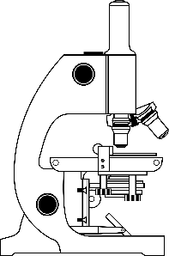



Assets that need to be protected
Business strategy
Competitive bids
Financial records
Payment card data
Research
Personal data
Trade secrets

Slide 6
Typical vulnerabilities and risks
Common vulnerabilities
Errors in scripts
No confirmation of receipt
Lack of encryption
Absence of fallback
Inadequate back-up
Over-reliance on key staff
Potential risks
Theft of data
Corruption of data
Misaddressed transfers
Introduction of malware
Transfer failures
Breaches of compliance

Slide 7

Compliance demands are mounting
All Sectors
  SOX, Combined Code, Companies Bill, IAS
  Privacy, Data Protection (GDPR), Human Rights
Finance Sector
  Basel II/III, GLBA, FFIEC, SEC Act 17a-3/4, NASD Rules 3010/3110
Retail Sector
  Payment Card Industry (PCI) Data Security Standard
Health Sector
  HIPAA
Interception legislation
  RIPA, European Data Retention Directive
Local legislation with Global consequences
  Californian Law SB 1386 et al

Slide 8
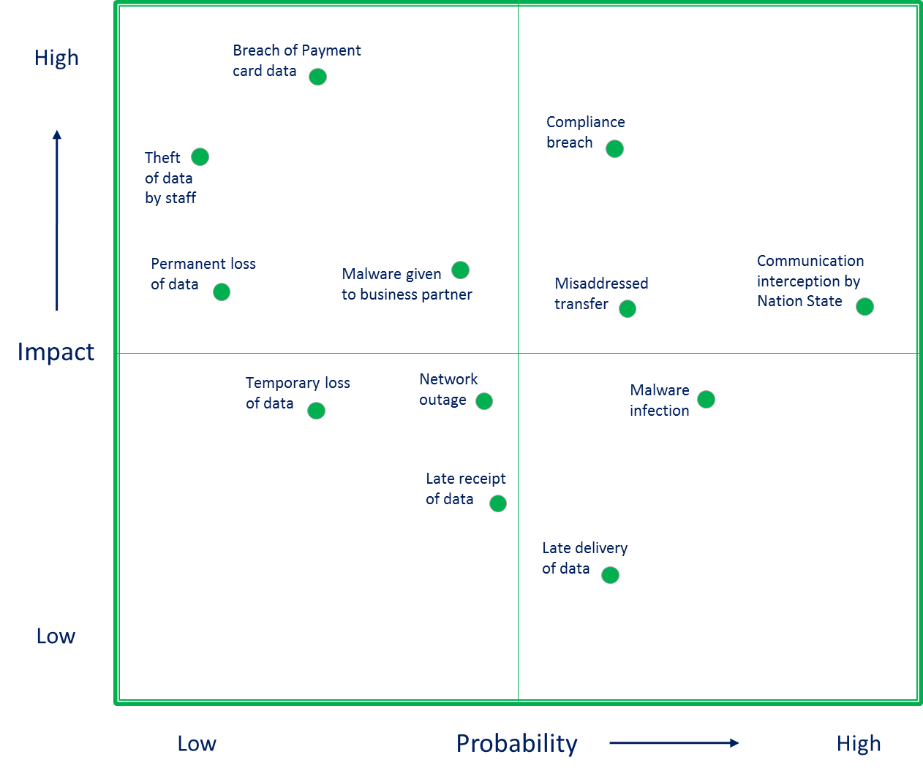
Example of a Risk Heat Map

Slide 9
Secure file transfer for data protection and compliance
Roles & responsibilities,
culture & attitudes,
skills & training,
organisation
People
Technology
Processes
Applications, architecture,
Infrastructure, cryptography
Policies, procedures, standards,
compliance processes

Slide 10
Secure file transfer technology features
Utility | Warranty
Accessible from any location | Continuously accessible (24x7x365)
Self-administered by business users | Automatic recovery from failures
Easy to implement and use | Assured back-up and business continuity
Fully automated transfers | Unlimited capacity and scalability
Authentication of recipients | End-to-end encryption of data
Guaranteed delivery and confirmed receipt | Assured integrity of transferred data
Simplicity of audit | Satisfies regulatory compliance
Works on all platforms | Evidential quality records

Slide 11
Not all processes are equal
Immature process
Ad hoc
Tactical
Fire-fighting
Rely on individuals
Ineffective
Inefficient
Uncertain
High risk of failure
Mature process
Defined
Managed
Measured
Controlled
Effective
Efficient
Predictable
Compelling
√

Slide 12
Visibility and control are the keys to security

Slide 13
Levels of secure file transfer maturity
Ad hoc and Informal
Planned and Tracked
Defined and Institutionalized
Managed and Measured
Optimizing and Agile
Operational benefits realized
Visibility & enforcement
Policy established & communicated
Requirements understood
Just muddle through

Slide 14
Critical success factors for secure file transfer
Risk mitigation
Automation
Agility
Governance
Policy

Slide 15
Critical success factors defined
Governance
How something is managed in terms of systems, protocols and accountabilities
Policy
A course or principle of action adopted by the organization
Risk mitigation
A reduction in exposure to a risk or its likelihood of occurrence
Automation
The automatic operation or control of a process or system
Agility
The power of moving quickly, easily and gracefully

Slide 16
How maturity impacts critical success factors
Governance
  From a reactive approach to a managed process aligned with business strategy
Policy
  From ad hoc advice to enforced policy encompassing all relevant compliance requirements
Risk mitigation
  From fragmented guesswork to solutions built to mitigate existing and emerging risks
Automation
  From manually controlled scripts to automatic guaranteed delivery
Agility
  From bespoke change projects to user managed changes

Slide 17
The Secure Transfer Service Capability Maturity Model
 | Ad hoc & Informal | Planned & Tracked | Defined & Institutionalized | Managed & Measured | Optimizing & Agile
Governance | Governance of file transfers focuses on reactive solutions to immediate business needs. | New file transfers requirements are assessed, planned and coordinated. | Mandatory formal processes and standards for file transfers are in place. | Responsibilities and targets for compliance with policies and standards are established. | Governance of file transfers is aligned with business strategy, and anticipates new business requirements.
Policy | No formal policy for information transfers. Controls rely on commonsense and best endeavors. | Policy statements exist, but are incomplete, not fully compliant with all regulatory requirements, and not effectively communicated. | A formal policy exists, consistent with legal and regulatory requirements, and is communicated to all key stakeholders. | A comprehensive policy is enforced through audits. Non-compliances are identified and remedial action taken. | The organization identifies and responds to emerging compliance requirements and continually improves the policy.
Risk mitigation | Little appreciation of risks or mitigating controls. File transfers could be vulnerable to interception, failure or misdirection. | Risk assessments are carried out, resulting in ad hoc mitigating actions, such as secure protocols and encryption. | Risks are understood and the organization has defined mitigating controls to safeguard the confidentiality, integrity and availability of file transfers. | File transfers are safeguarded from identified risks through pre-defined and audited solutions and controls. | Existing file transfers are safeguarded and emerging risks are identified, assessed and mitigated before they become significant.
Automation | Most file transfers are controlled manually, supported by simple ad hoc scripts. | File transfers exploit re-usable, professional scripts and basic cryptographic services. | Standards for file transfers address authorization, confidentiality, integrity, non-repudiation, and traceability. | A specialist file transfer service ensures the consistency, efficiency and compliance of file transfers. | A professional secure transfer service takes care of file transfers, guaranteeing security, reliability, recovery, scalability, and compliance.
Agility | Change requests require research and approval. | Change requests are managed as bespoke projects. | Change requests are managed as system enhancements. | Change requests are managed as standard changes. | Authorised business users can quickly implement or change file transfers.

Slide 18
Growing maturity, changing focus
Optimizing and Agile
Ad hoc and Informal
Planned and Tracked
Defined and Institutionalized
Managed and Measured
Exploit technology for
business agility
Implement technology for
visibility and measurement
Extend and embed
management system
Establish basic
management system
Maturity level
Strategic focus

Slide 19



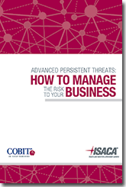
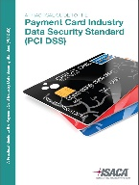
Thank you all for listening
David Lacey

Slide 20
Poll question #2: Does your current file transfer solution provide access to centralized logs for audit and compliance?
Yes
No
Don’t know

Slide 21
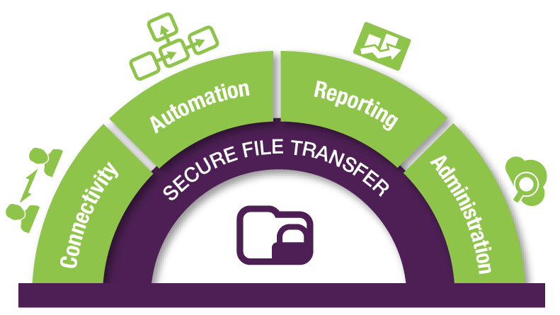
Managed File Transfer Capabilities
Notes:
Point:
MOVEit has capabilities that extend beyond traditional file transfer systems to what is known as “Managed File Transfer”. Managed File Transfer delivers enterprise-level security and management including:
Secure File Transfer
Transfers files between systems and people
Supports hardened security and a broad range of protocols
End-to-end Encryption, authentication and delivery confirmation
Guaranteed delivery, scalability and reliability, including high availability, failover and disaster recovery
User Connectivity
Allowing users to connect from mobile, email, web, sync clients and clients that enable integration with backend systems
IT controls user access
Ease of use, flexibility for wide adoption across the organization and to external partners
Automation Capability
Transfers and routes files to get business done
Controls file transfers to automate business processes
Integrates with existing scheduling apps
Simple to use point-and-click interface with no programming required
Replaces traditional scripts – can reduce backlog from avg 2 – 4 weeks to same day turnaround
Reporting Capability
Visibility and control
Reports for auditing Compliance and governance to meet corporate security policies and government regulations
Administration and Provisioning
MOVEit offers federated administration enabling end-users to on-board partners and users reducing workload for IT administrator
Enabled to set up users, groups, and accounts
On-boards partners
Secure access control

Slide 22
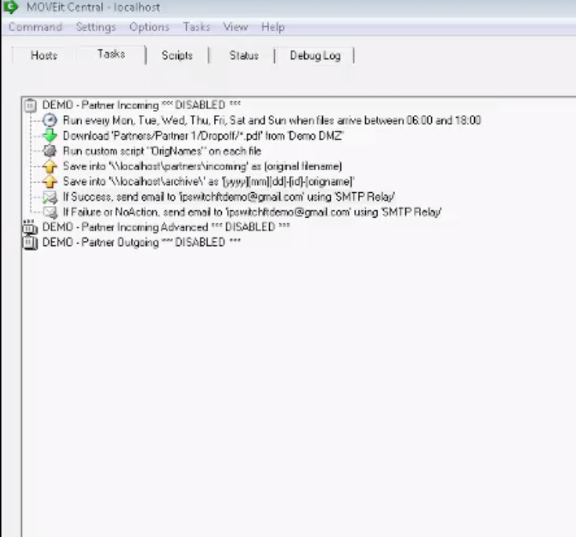
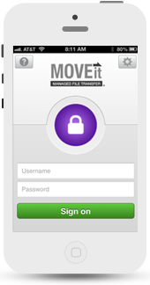
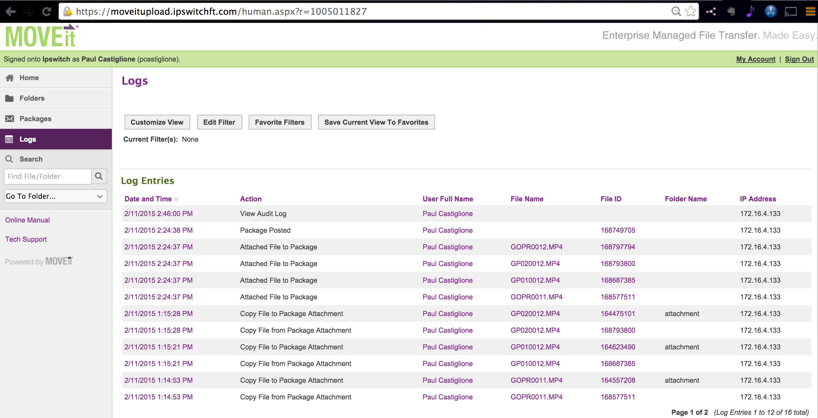
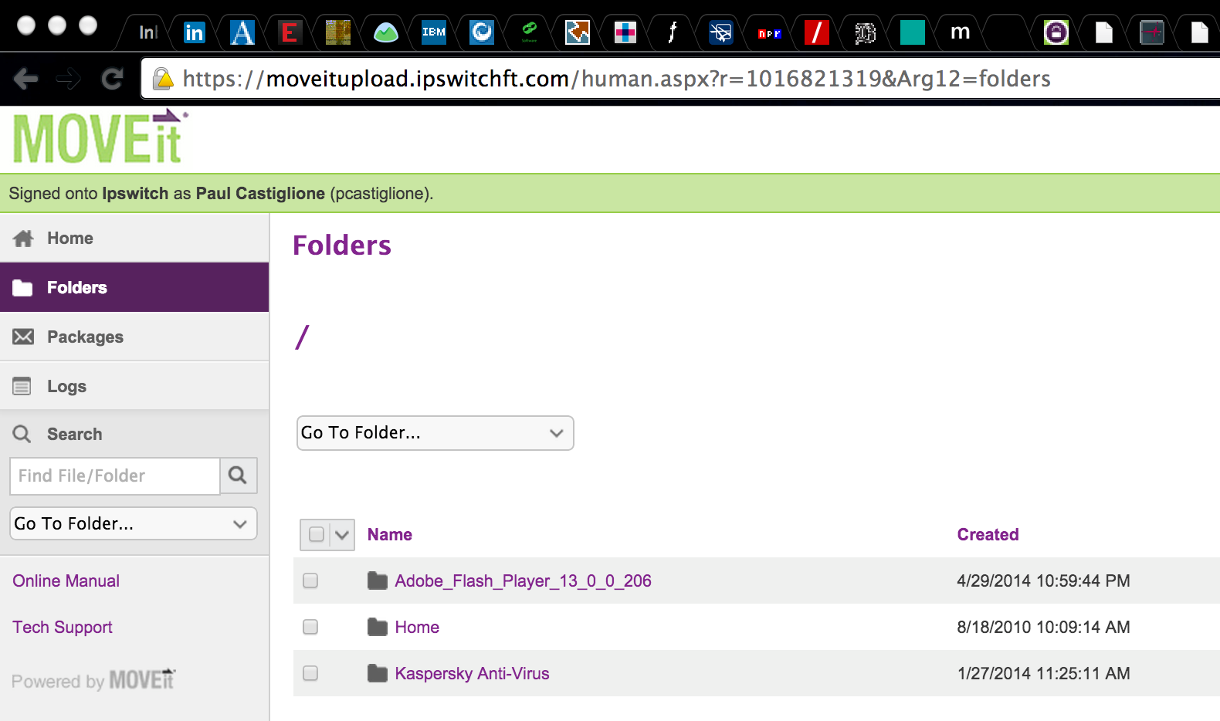
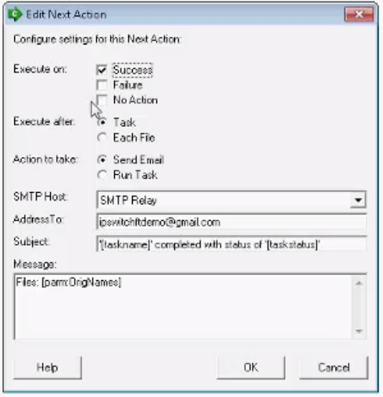
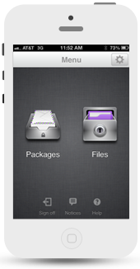
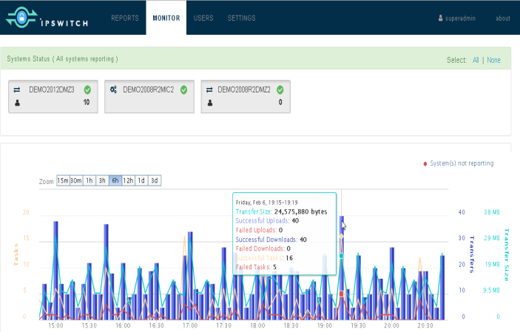
MOVEit Managed File Transfer
User self-management
Supports lots of devices/clients
Automation without programming
Automate Reporting and Monitoring

Slide 23
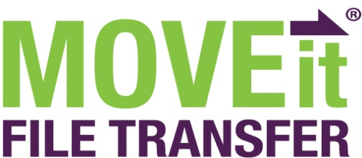



MOVEit Managed File Transfer Components
Secure Server
for Moving Files
Easy and Reliable
File-based Automation
Flexible Reporting and Monitoring for MOVEit MFT
Ad Hoc Transfer: Employees and partners can send sensitive files
Mobile: Productivity for your Mobile Workforce
Failover, HA & Disaster Recovery: Provides scalability for performance and unattended failover in seconds or minutes with zero data loss for uninterrupted operations
API: Provides programmatic access to core file transfer services.
ADD-ON MODULES
Notes:
Point:
MOVEit Managed File transfer is comprised of two key components: MOVEit File Transfer (DMZ) Server and MOVEit Central.
MOVEit File Transfer Server has following key add-on modules: Ad Hoc Transfer; Mobile; HA (Webfarm); Disaster Recovery; and API
MOVEit Central has the following add-on modules: Failover and API

Slide 24


MOVEit Managed File Transfer Components
Secure Email Attachment
Professional
Premium
Employees and partners can send sensitive files
Transfer sensitive files using folders from anywhere including mobile devices
Access all features in Secure Email Attachment and Professional options
3rd party-validated compliance
Perimeter, app, DB, web server firewalls with defined rule sets
Scalable, HA, & Disaster Recovery with 99.9% guaranteed uptime
Intrusion Detection / Pen Testing
Hardened Datacenter: CIS benchmarks & SSAE 16 Type II audited
Budgeted cost and lower risk
UNIQU
BENEFITS
Notes:
Point:
MOVEit Cloud has 3 purchase options
MOVEit Cloud offers unique benefits (over MOVEit MFT on-premises)

Slide 25
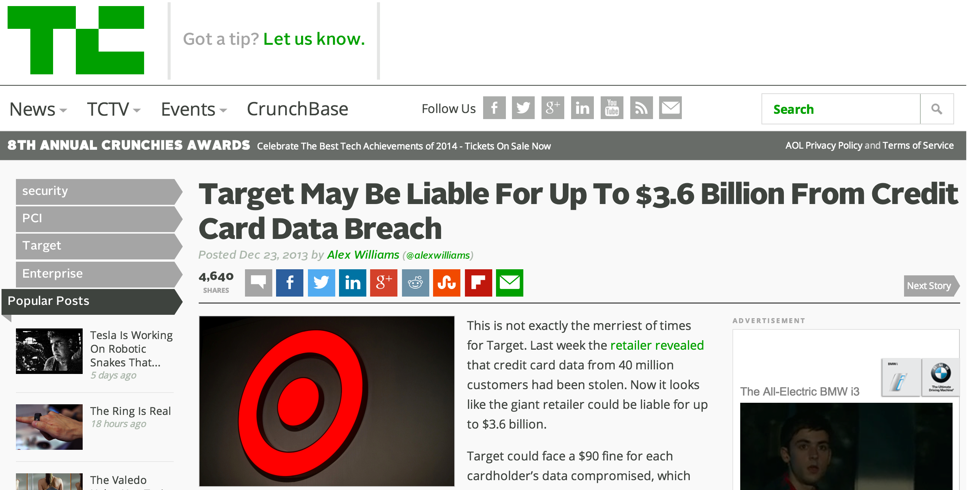
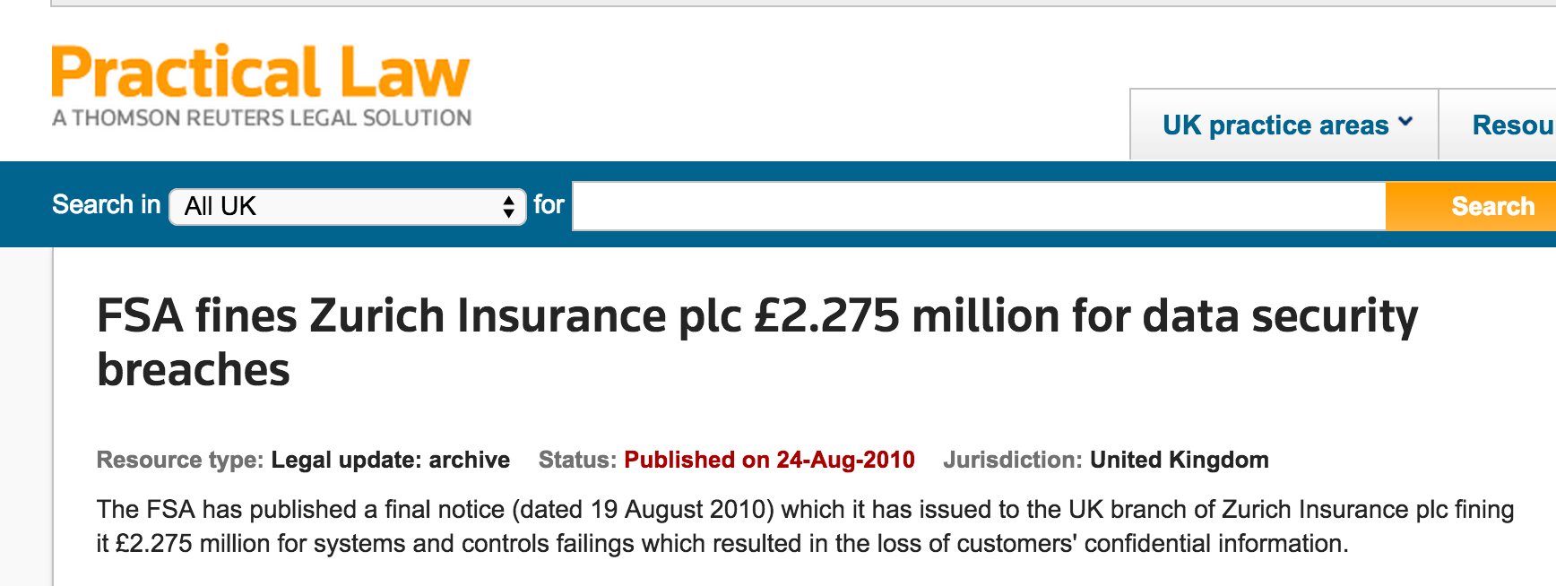
Impact of Digital Do-it-yourself File Transfer
Cost of lost data is high.
Cost of non-compliance is high.
The cost to
maintain existing systems is high.
>$125,000 additional file transfer cost every year*
Hidden cost of traditional FTP systems vs a managed file transfer solution:
Assuming 10,000 files transferred per year organization-wide
4% – 5% of all transfers contain errors
4 – 5 hours per incident to troubleshoot/fix
$55 / hr cost for IT admin (salary and overhead)
* Aberdeen report, 2013
Notes:
Point:
Cost and risk of not upgrading existing systems can be high:
Cost of lost data is $3.5M / company, experienced data breach and 43% of companies interviewed had experienced a breach in 2014 (Ponemon Research 9/13/2014 report)
Cost of PCI-DSS non-compliance is estimated to be $182 / per lost record according to Ponemon 2006 report
Additional cost of using existing file transfer systems instead of upgrading to a managed file transfer solution is roughly the annual salary of 1 headcount based on results of a survey of 200 IT professionals conducted by Aberdeen Research in 2013 – report available for download from ipswitchft.com)

Slide 26
Additional Resources
Live demonstration of MOVEit Managed File Transfer http://resources.ipswitchft.com/Managed-File-Transfer-Demonstration-Series.html
Free 30-day trial of MOVEit Managed File Transfer http://www.ipswitchft.com/app/evaluate/moveit.aspx
Free copy of Managed File Transfer for Dummies ebookhttp://resources.ipswitchft.com/WP-Managed-File-Transfer-for-Dummies.html
Notes:
I’ll ask for any final thoughts from you.

Slide 27

www.Ipswitch.com/virtual-summit

Slide 28
Questions?
Thank You for Your Attention!

Slide 29
Poll question #3: Are you interested in scheduling a demo of MOVEit Managed File Transfer?
Yes – please contact me
No thank you

Slide 30
Data Transfer: Stay in Focus,
Stay Secure
Paul Lanois
24 September 2015

Slide 31

Profile
Paul Lanois
Education
Attorney-at-law
Certified Information Privacy Professional (CIPP)
J.D./Master in Law, University of Paris - Sorbonne (France)
LL.M, University of Pennsylvania Law School (USA)
Certificate in Business and Public Policy, The Wharton School of the University of Pennsylvania (USA)
Professional Experience
Associate at various international law firms: Simpson Thacher & Bartlett LLP, Allen & Overy LLP, Linklaters LLP
Associate Professor, University of Cergy-Pontoise (France)
Areas of focus
Privacy Law and Data Protection Law
IT Law
Cross-Border Legal
Company Law and Corporate Governance

Slide 32
Overview
Why is securing data transfers important?
  Not just an issue for banks and governments!
  Ensure confidentiality, integrity, availability
  Protect critical assets from cyber threats
  Data is often is one of the most valuable assets that a company may have – “Is Data The New Oil?” (Forbes, 2012)
  Reputation and loss of trust - “It takes 20 years to build a reputation and five minutes to ruin it. If you think about that, you'll do things differently.” (Warren Buffett)
  Requirement to comply with data security laws
  Failure to comply and provide privacy, audit and internal controls could result in penalties ranging from large fines to jail terms.
  According to a recent study conducting by the Ponemon Institute and sponsored by IBM, data breaches cost companies in the United States an average of $217 per compromised record, with the total average cost paid by organizations amounting to $6.5 million.

Slide 33
U.S. Privacy laws
Federal laws regulating the private sector
  No all encompassing federal privacy standard - sectorial approach
  Specific to certain industries:
    Financial transactions
    Credit reports
    Law enforcement
    Medical records
  FTC Act Section 5 prohibits unfair or deceptive trade practices
    Failure to employ reasonable and appropriate security measures deemed an unfair practice
    2006: ChoicePoint case - $10 million in civil penalties and $5 million in consumer redress

Slide 34
U.S. Privacy laws
State specific privacy laws
  Early 2000s: states started enacting legislation requiring the notification of security breaches of information involving the unauthorized disclosure of “personally identifiable information”
  Data owners and data stewards must notify residents whose unencrypted information was/may have been acquired by an unauthorized person.
  Personal Information that triggers the obligation to notify residents typically consists of an individual’s name plus one or more of the following:
    Social security number
    Driver’s license number
    Bank account or debit/credit card number (along with PIN or access code)
    Medical information/health insurance information
  Some states require consumer notice upon determination that harm is likely or that there is a significant risk of identity theft or if unencrypted information was merely accessed.

Slide 35
Encryption
Some states impose encryption requirements – for example, the Nevada Code (NRS 603A.215) states that unless a data collector doing business in Nevada complies with the current version of the Payment Card Industry (PCI) Data Security Standard, it may not:
a) Transfer any personal information through an electronic, non-voice transmission other than a facsimile to a person outside of the secure system of the data collector, unless the data collector uses encryption to ensure the security of electronic transmission; or
b) Move any data storage device containing personal information beyond the logical or physical controls of the data collector or its data storage contractor, unless the data collector uses encryption to ensure the security of the information.

Slide 36
European Union
Directive 95/46/EC of the European Parliament and of the Council (the “Privacy Directive”), passed in October 1995
Directive 2002/58/EC of the European Parliament and of the Council (the Directive on privacy and electronic communications, or the “E-Privacy Directive”), passed in 2002
Privacy Directive not uniformly implemented by EU Member States
Enforcement issues: when Google changed its privacy policy to aggregate users' personal data from across all their Google accounts and services, it faced different sanctions from local data protection authority. For example, the Spanish regulator imposed a maximum fine of €900,000, the French regulator imposed a fine of €150,000, whereas the Dutch regulator threatened a fine of €15m.
Additional Protections (e.g. German Worker Councils)
Upcoming General Data Protection Regulation

Slide 37
Cross-Border Data Transfers
Transfers of personal data outside the EU permitted only in certain situations – one of them being that the country receiving the data has an “adequate level” of privacy protection.
Safe Harbor – annual certification required
Model Clauses – standard contractual clauses recognized as offering adequate safeguards
Binding Corporate Rules – allow multinational groups to transfer personal data that they control from the EEA to their affiliates outside the EEA
29 December 2014: Hong Kong regulator issued a “Guidance on Personal Data Protection in Cross-Border Data Transfer” proposing future restrictions to cross-border transfers of data

Slide 38
Data Transfer: Stay in Focus, Stay Secure
Q&A
Panel:
David Lacey MD, David Lacey Consulting Ltd
Paul Castiglione
Senior Product Marketing Manager, Ipswitch
Paul Lanois,
attorney-at-law

Slide 39
Thank you for attending
Upcoming webinars:
8th October: Fighting Cyber-Attacks Through Security Intelligence
22nd October: The Kick Inside – Dealing with Threats from Within your Firm
https://www.infosecurity-magazine.com/webinars/
Virtual Conference – NEXT WEEK!
29th September (EMEA) & 30th September (North America)
Extensive education programme, high calibre speakers, engaging video content, download materials and communication portal where speakers, exhibitors and colleagues can meet and network

